Slide 1
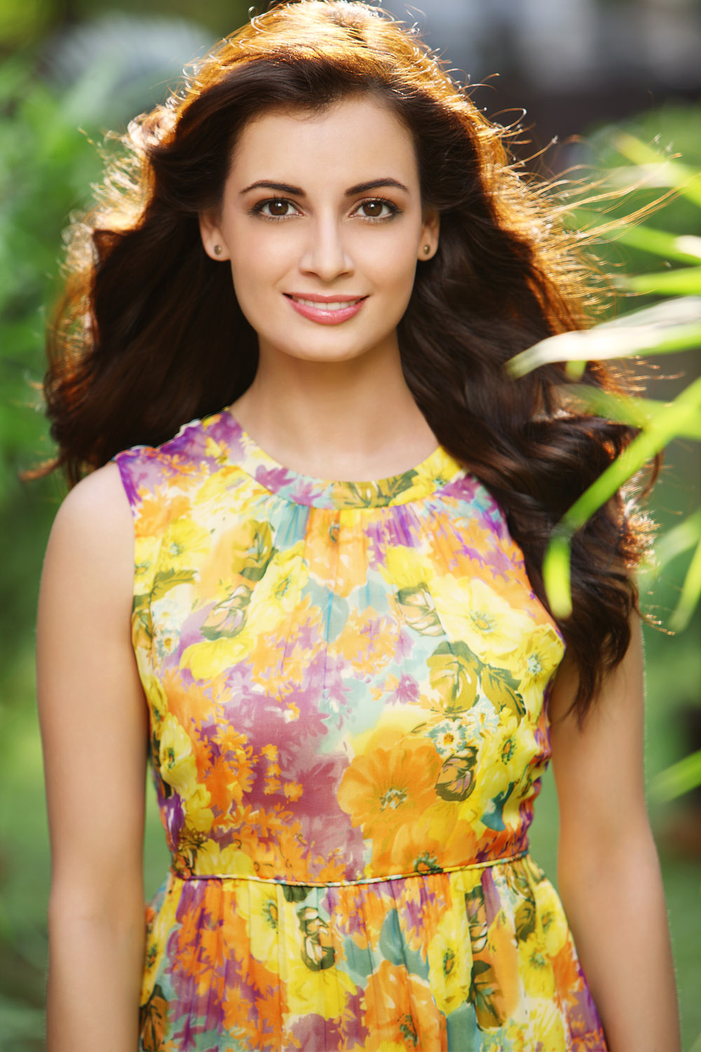
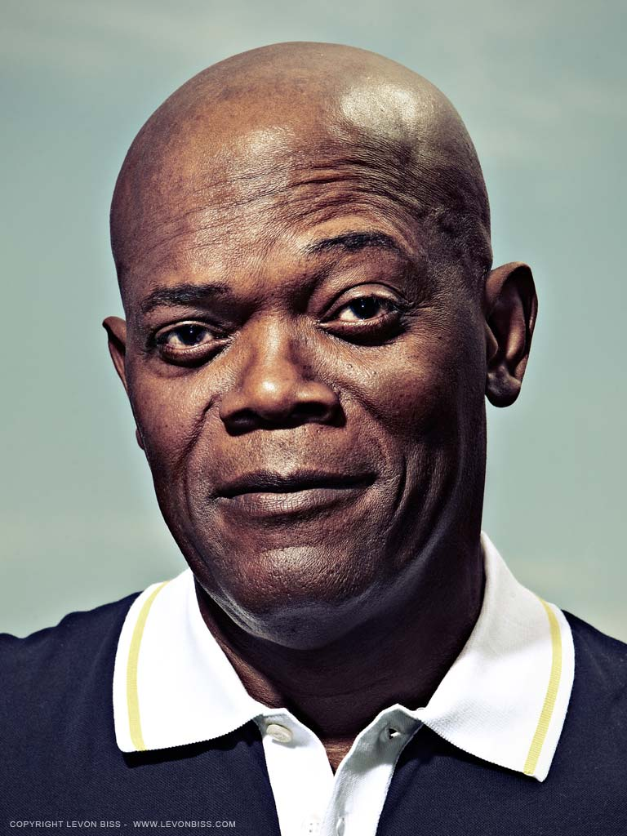
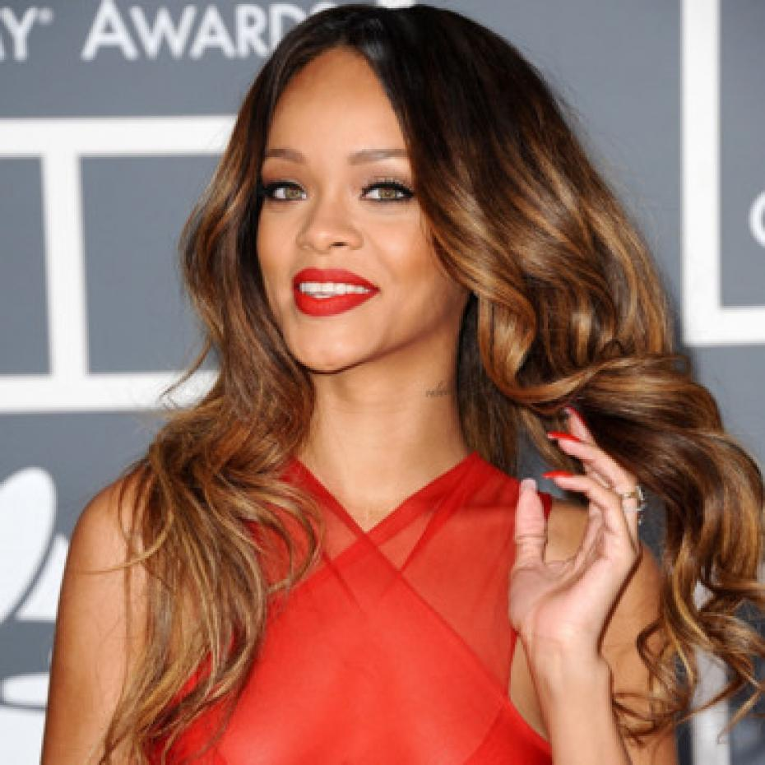
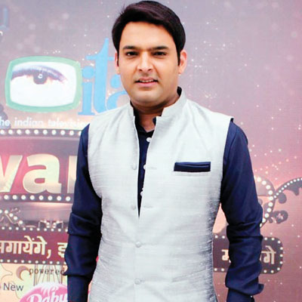
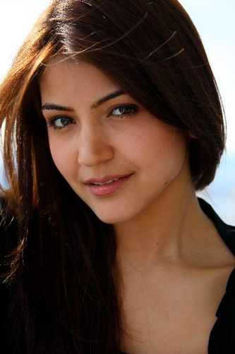
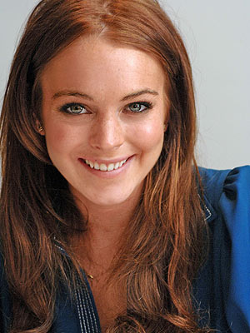
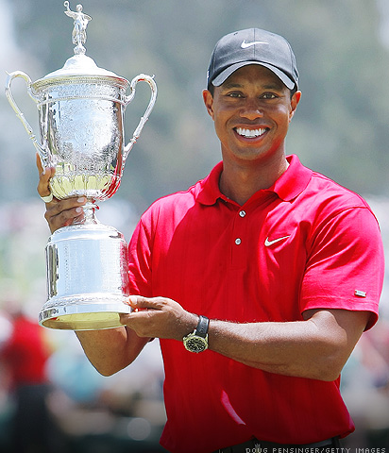
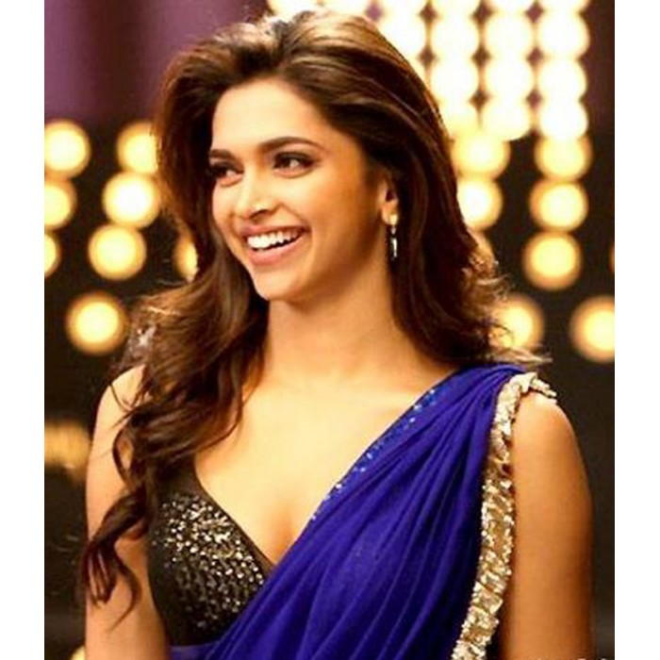
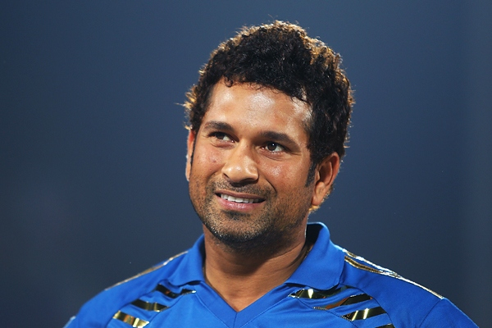
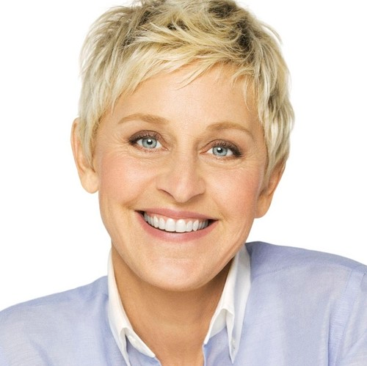
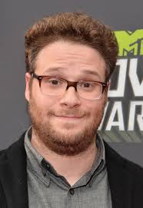
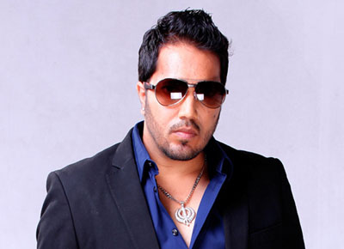
Celebrity Popularity Index – Brand Advertisement

Slide 2
Agenda
Business Overview
Business Goals and Objectives
Our Approach
Data Sources
Modeling
Results

Slide 3
Business Overview
Company X is planning to launch Product ABC in the United States and in India.
Company X is interested to choose a celebrity in each region to endorse the new product.
Company X wants to make this decision by gauging different celebrities’ social media presence.
Company X understands the importance of social media and how consumer interests are tied into that.

Slide 4
Business Goals and Objectives
Our Goal is to provide Company X with a predictive model which will enable the organization to determine the degree of popularity of a celebrity.

Slide 5
Our Approach
We have collected Facebook posts and Twitter tweets for 100 celebrities with vast ranges in age, public perception, and popularity.
We utilized the collected data to determine how those factors play into a celebrity’s social media presence.
We have applied classification on the celebrity data to create a decision tree which will help Company X to make the right decision to select a celebrity to endorse company’s new product

Slide 6
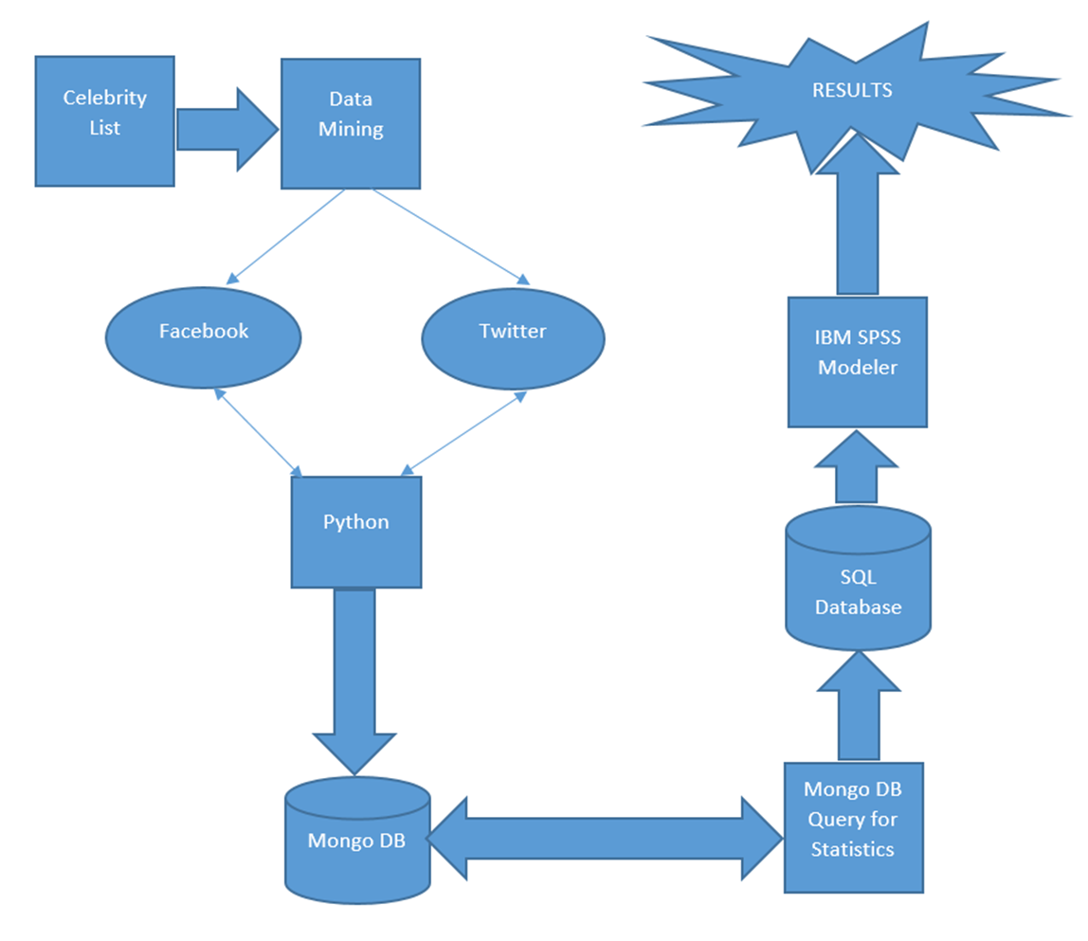
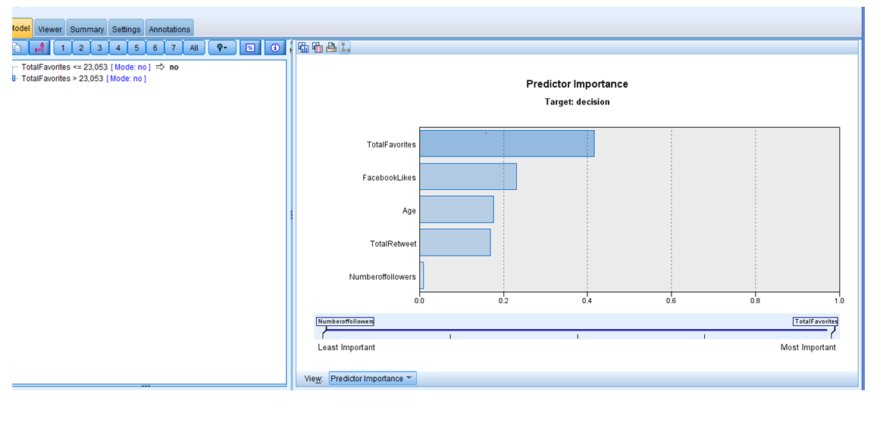
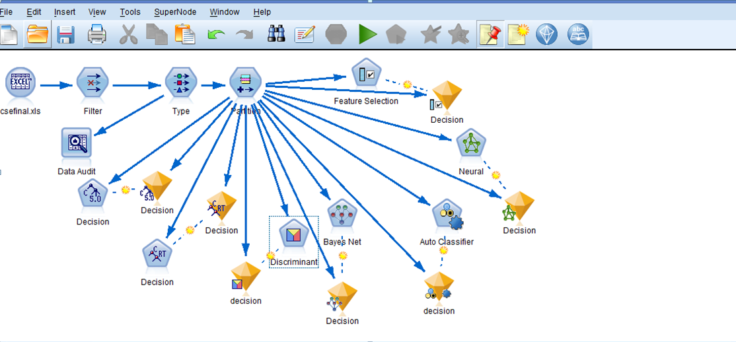
Data Flow Diagram
Predictive Model
Execute python scripts to collect Facebook posts and Twitter tweets
Load the CSV file into SQL Server Database
Execute JavaScript to collect values of the fields from the MongoDB collections and export the data into CSV values
Store posts and tweets in BSON format in MongoDB collections

Slide 7
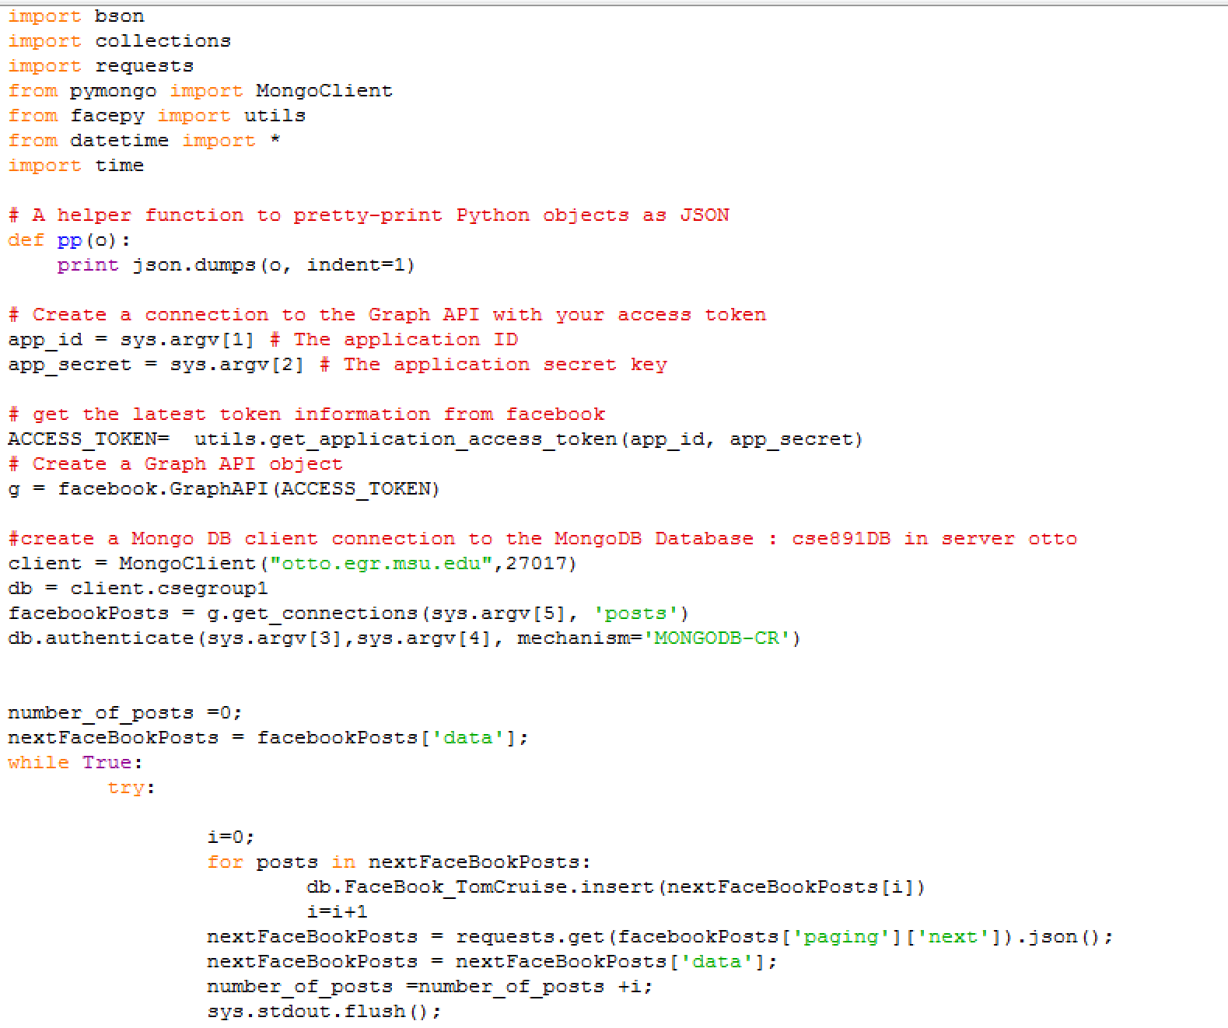
Data Collection - Facebook
Create Facebook Graph API to connect to Facebook Page
Insert the Facebook Posts into MongoDB collections
Notes:
Challenge was to automate the token process so we didn’t have to enter that every time.
Another challenge was storing the data, so the inserting section has taken care of that.

Slide 8
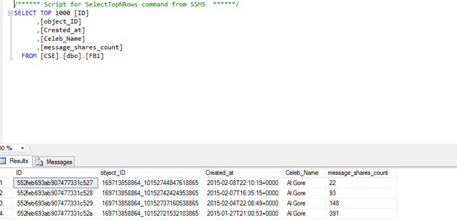
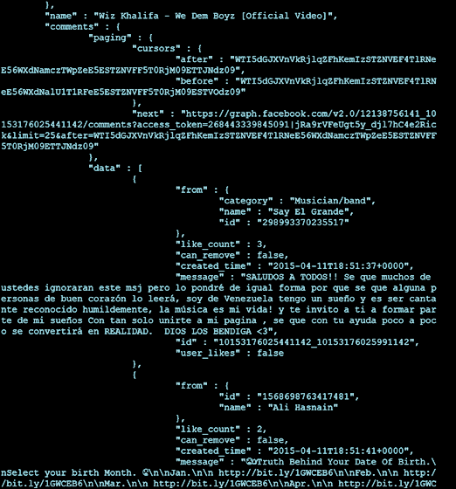
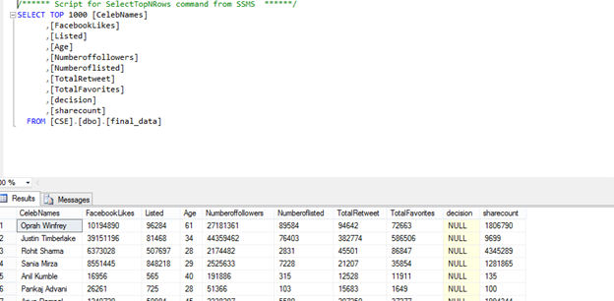
Data Storage - Facebook
Mine mongoDB
printJs-Facebook.js
SQL

Slide 9
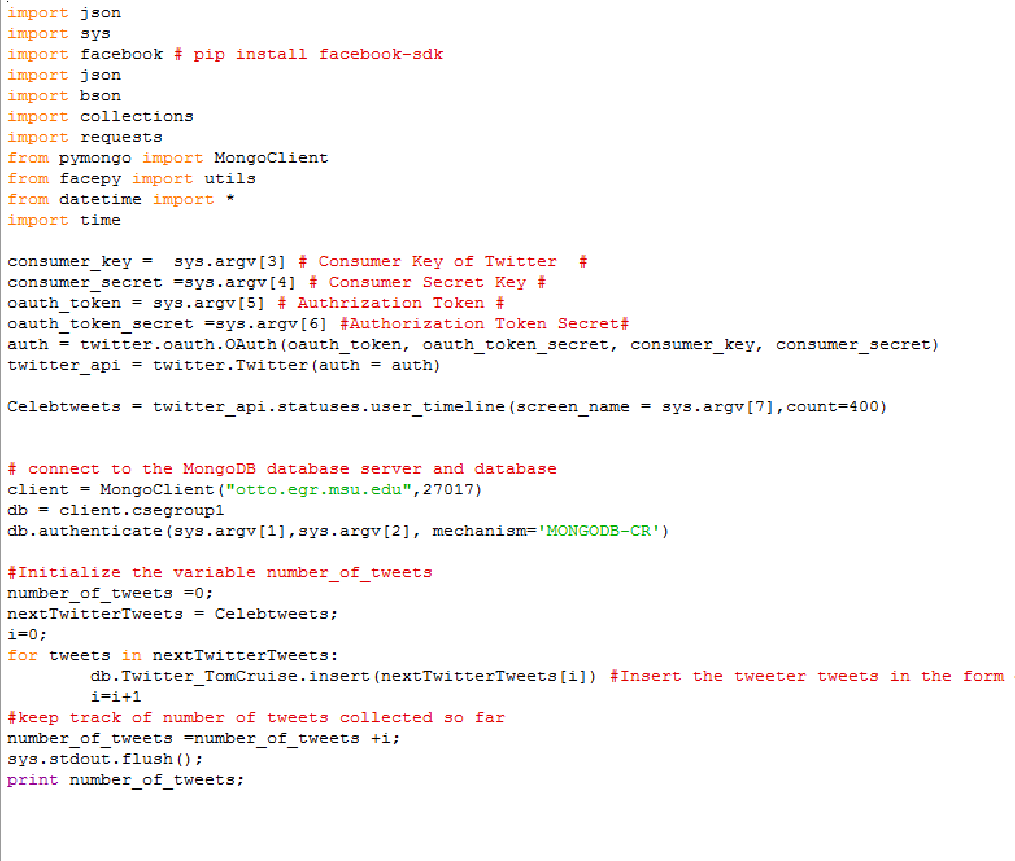
Data Collection - Twitter
Get the user timeline using the Twitter API package.
Insert the twitter tweets BSON format into MongoDB collections
Notes:
Challenge was to automate the token process so we didn’t have to enter that every time.
Another challenge was storing the data, so the inserting section has taken care of that.

Slide 10
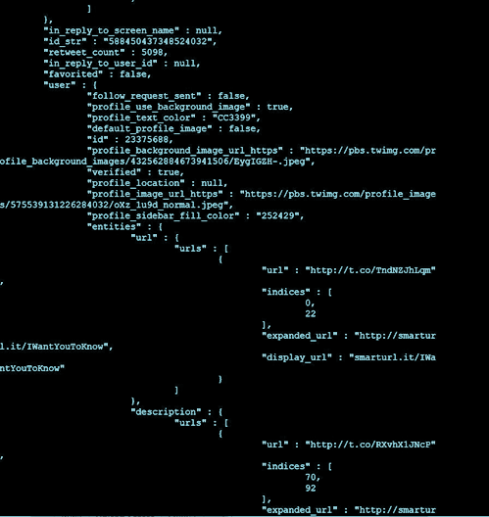
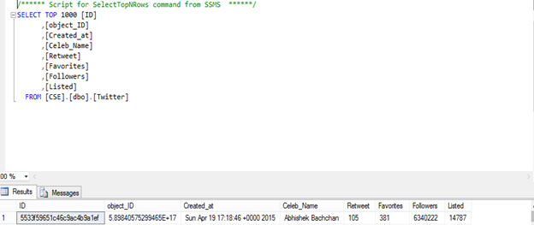
Data Storage - Twitter
Mine mongoDB
printJs-Twitter.js
MySQL

Slide 11

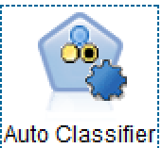
Predictive Modeling Using IBM SPSS
Inputs
FacebookLikes
Listed Count
Age
NumberOfFollowers
NumberOfListed
TotalRetweets
TotalFavorites
ShareCount
Target
Decision : Popular Celebrity (Yes/No)

Slide 12
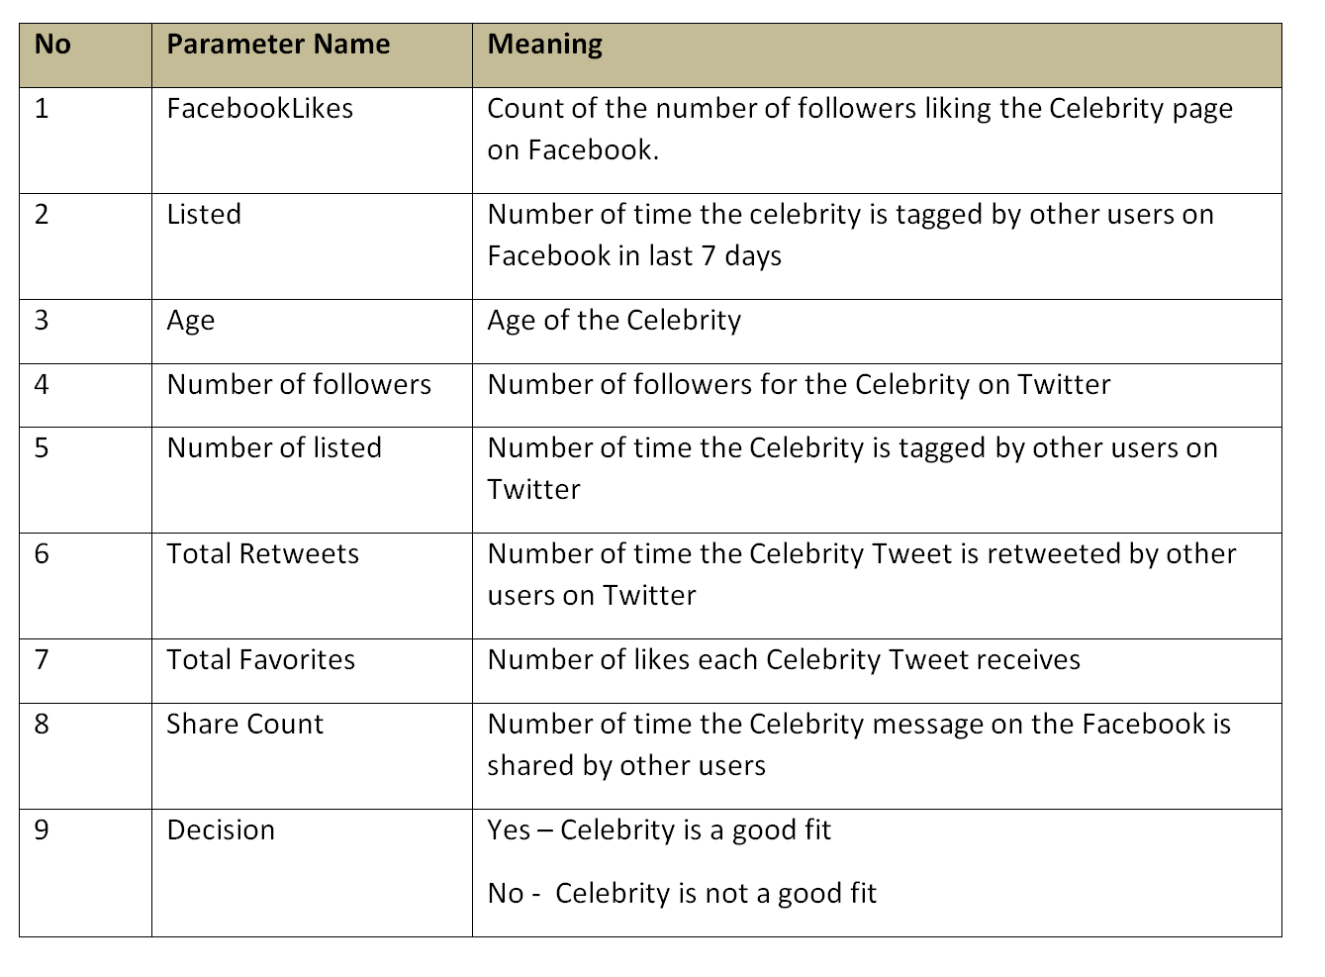
Data Dictionary

Slide 13
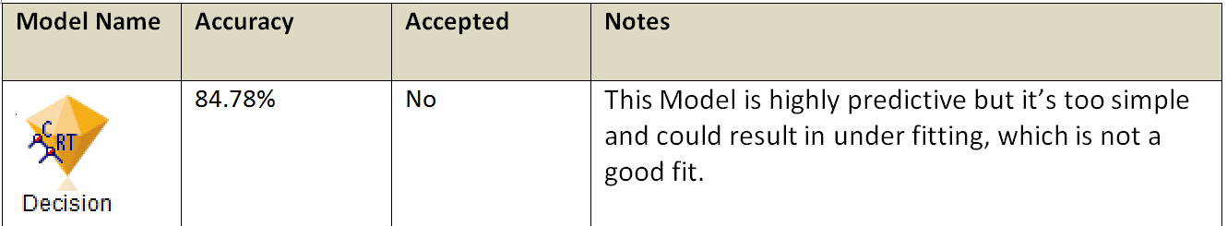
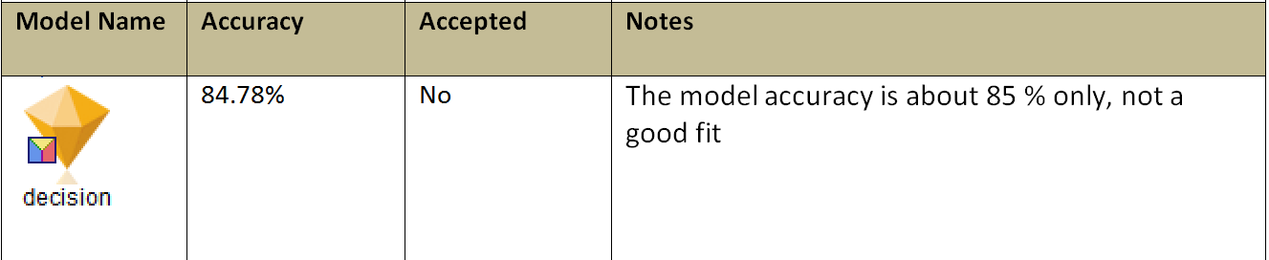
Predictive Models in IBM SPSS
IBM SPSS generated three models : C&R Tree, Discriminant and C5.0.
Acceptance Criteria : Model Accuracy more than 90%

Slide 14
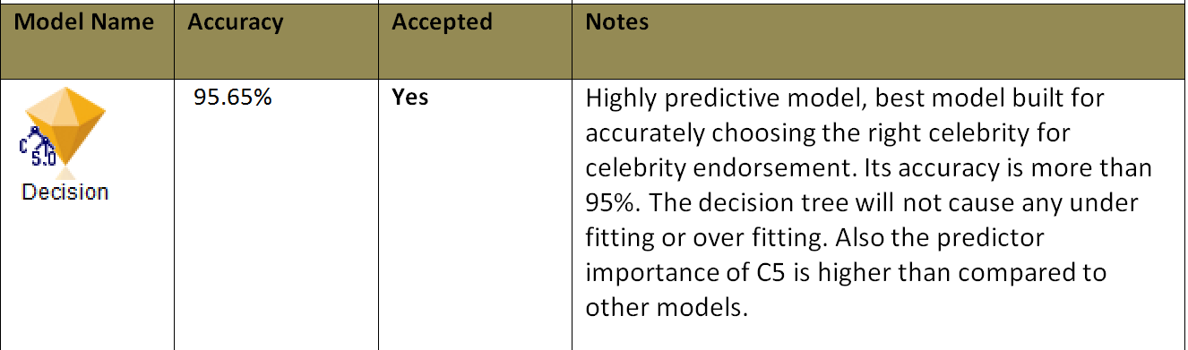
Predictive Models in IBM SPSS

Slide 15
Keys to Celebrity Selection...
Celebrity must have a Facebook and Twitter page
Celebrity must be young (less than 50)
Total number of Favorites on Twitter has to be more than 23K
Facebook Likes should be more than 5M
Twitter Retweets has to be more than 200k

Slide 16
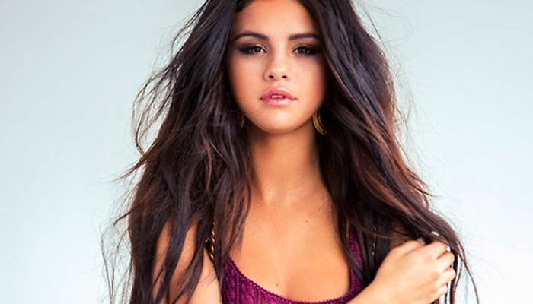
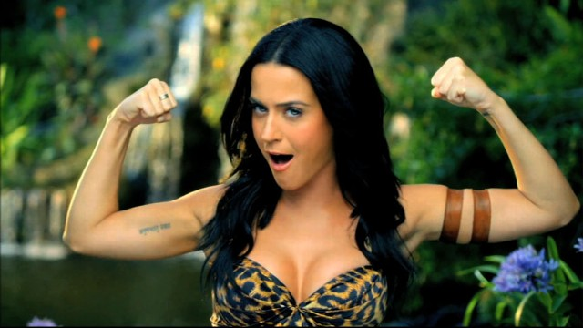
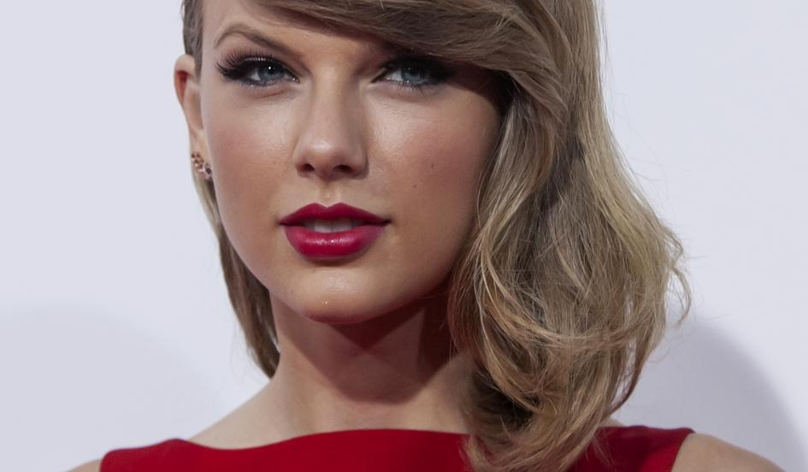
Selena Gomez
Katy Perry
3
1
2
Taylor Swift

Slide 17
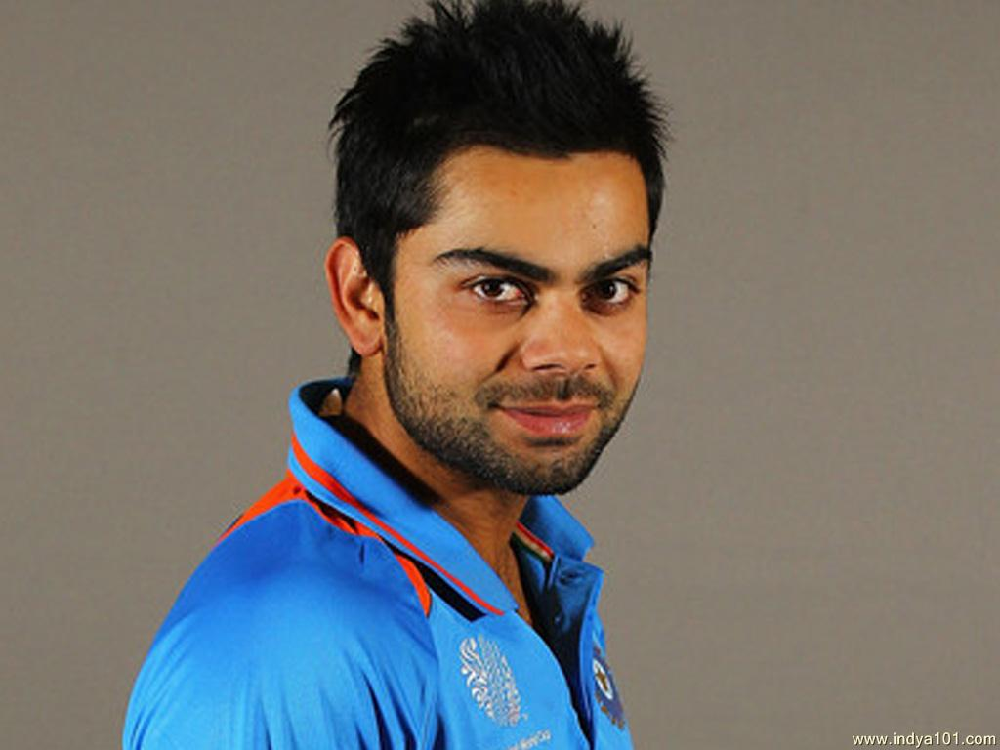
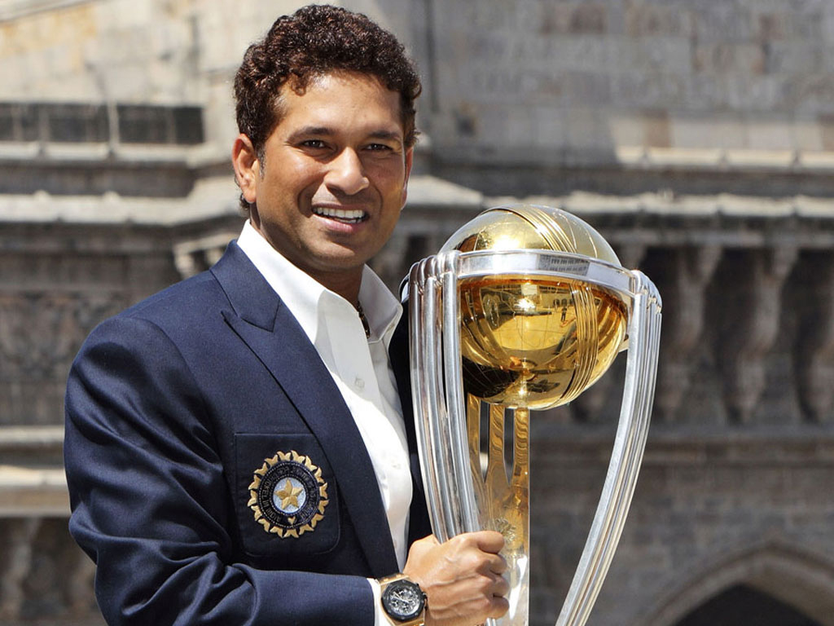
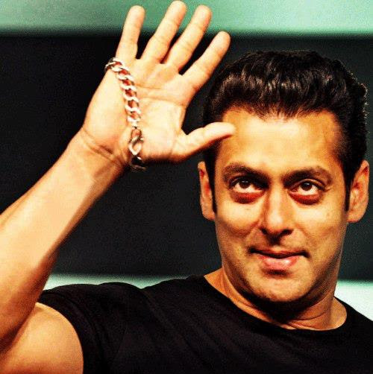
Virad Kohli
Sachin Tendulkar
3
1
2
Salman Khan

Slide 18
Thank You!
Questions?

Slide 19
Appendix

